Slide 1

AMSTer : SAR & InSAR Automated Mass processing Software for Multidimensional Time series
Nicolas d’Oreye^{1,2}, Dominique Derauw^{3,4}, Sergey Samsonov⁵,
Delphine Smittarello¹, Maxime Jaspard¹, Gilles Celli¹
ndo@ecgs.lu
amster@ecgs.lu
1 European Centre for Geodynamics and Seismology (ECGS), 19 rue Josy Welter, L-7256 Walferdange, Luxembourg
2 National Museum of Natural History (NMNH), 19 rue Josy Welter, L-7256 Walferdange, Luxembourg
3 Centre Spatial de Liège (CSL), Avenue du Pré Aily, B-4031 Angleur, Belgium
4 SAREOS, 1 Rue des Violettes, 4557 Fraiture, Belgium
5 Canada Centre for Mapping and Earth Observation, Natural Resources Canada (NRCAN), 560 Rochester Street, Ottawa, ON K1A 0E4, Canada

Slide 2
Mass Processing:
Baseline plot, Coregistration on a super master and DInSAR computation of all pairs.
Nicolas d’Oreye

Slide 3
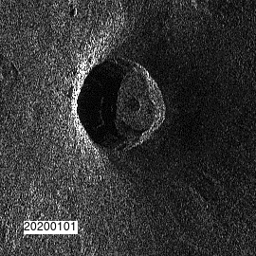

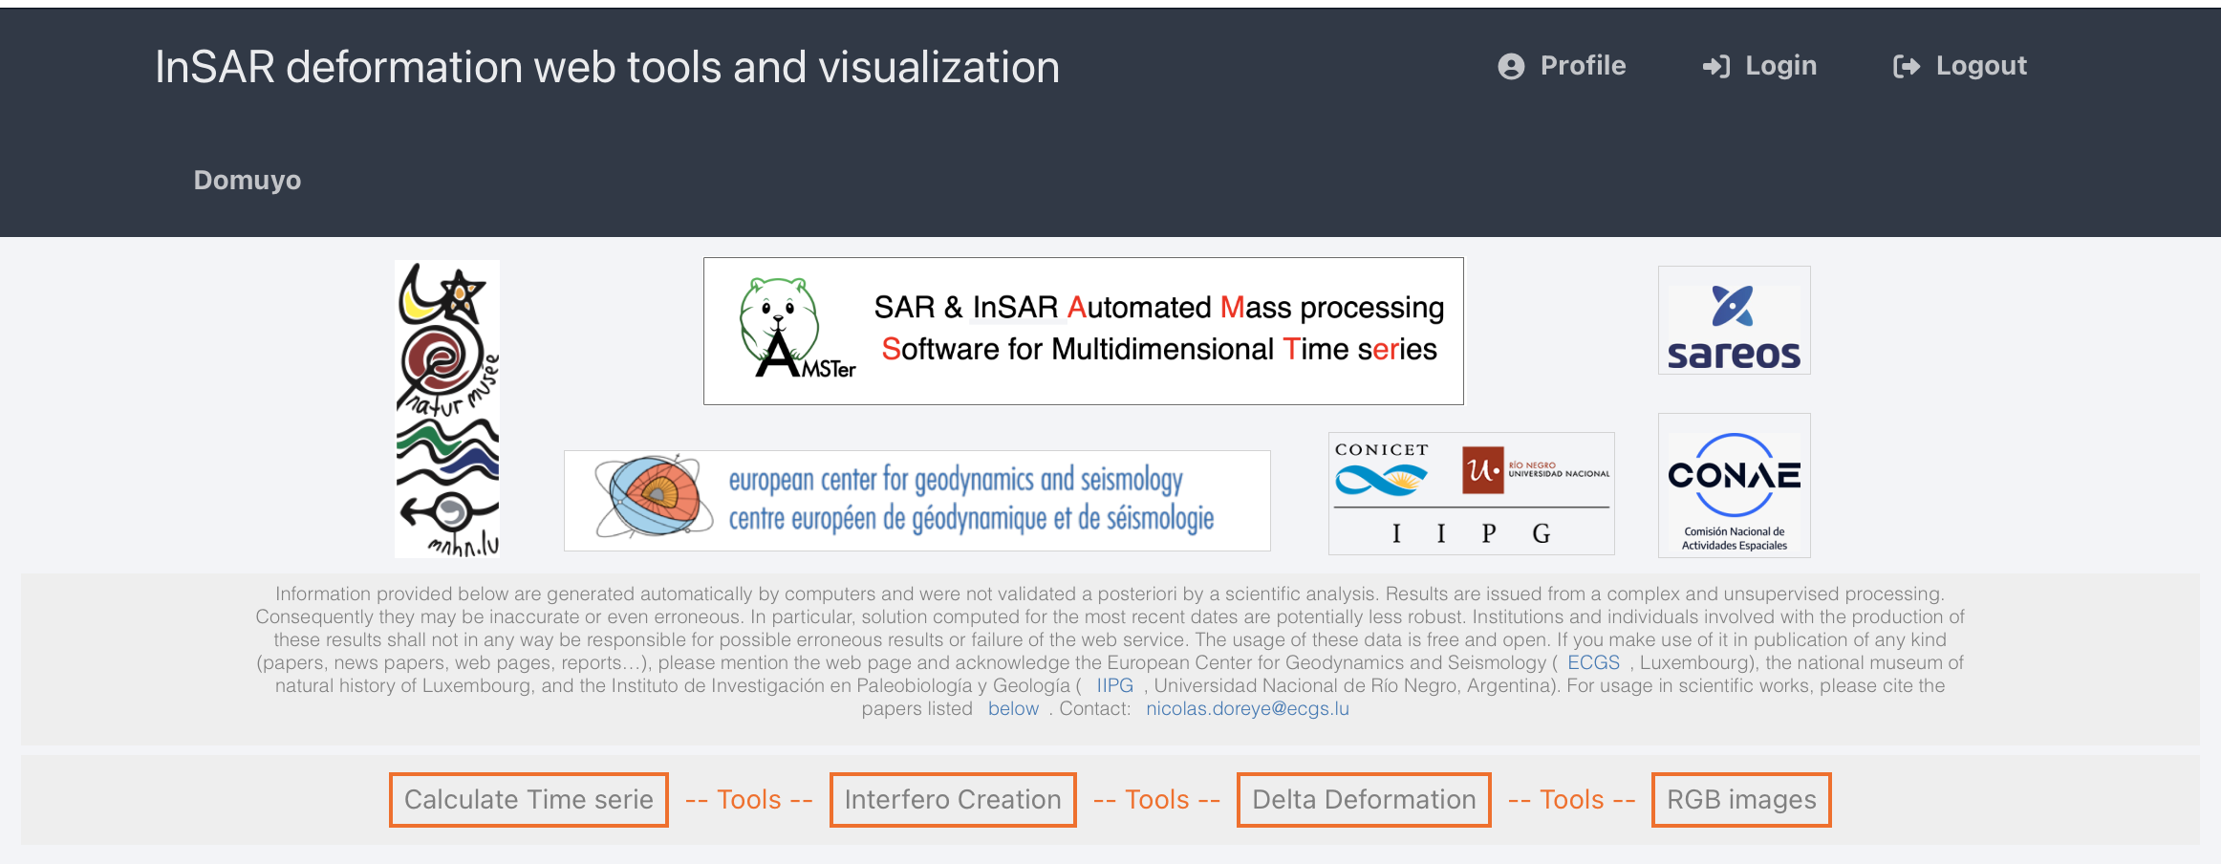
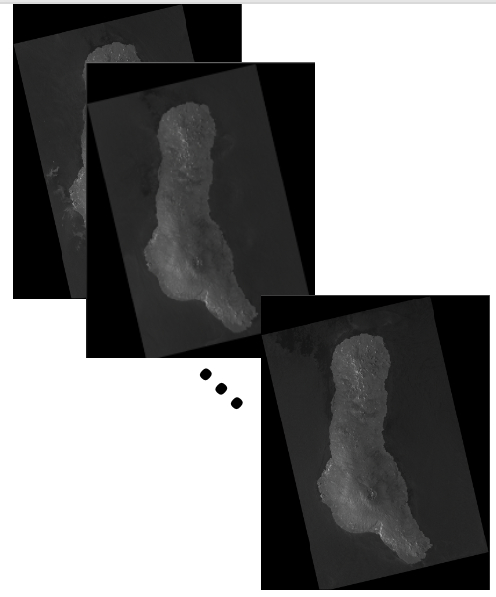
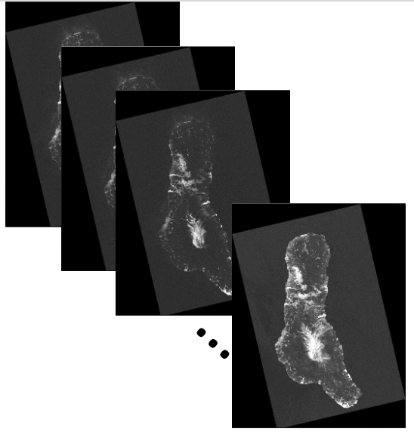
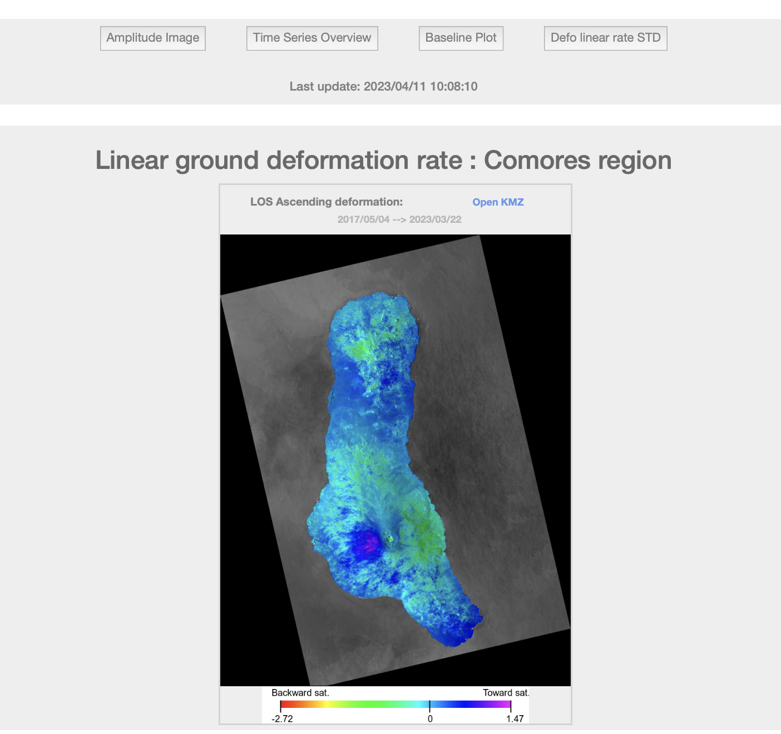
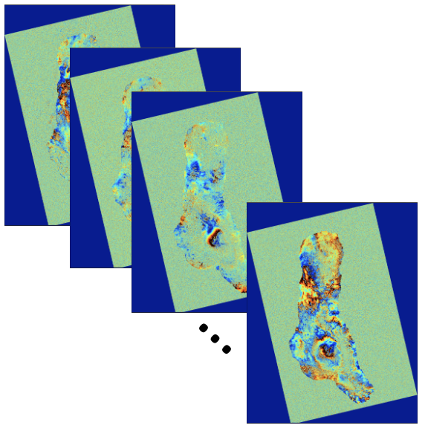
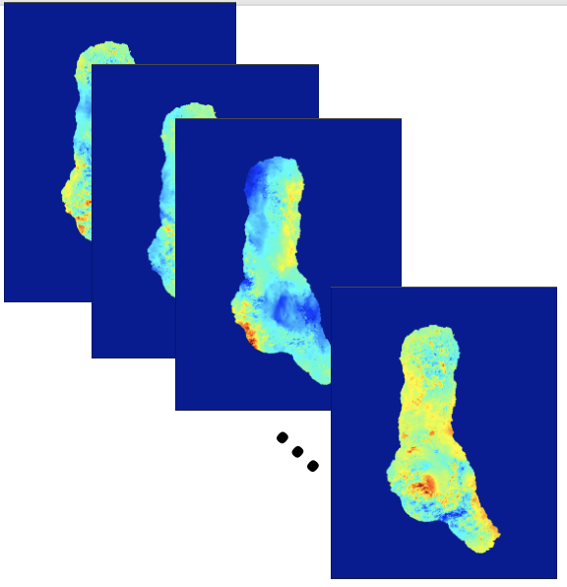
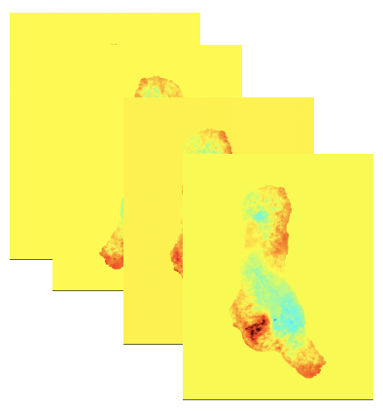
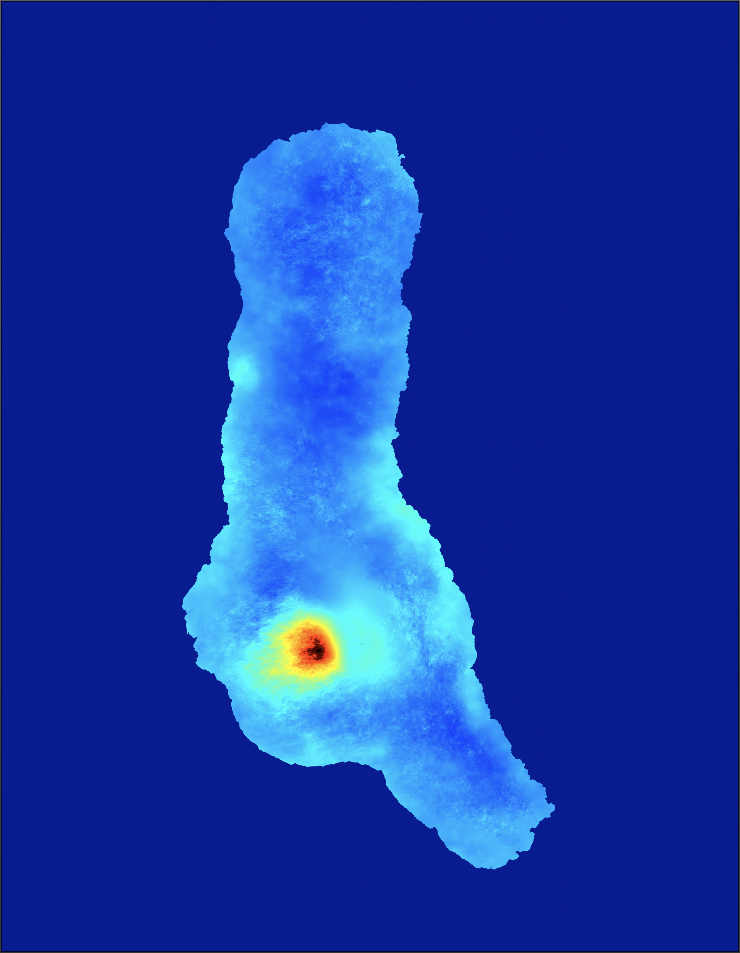
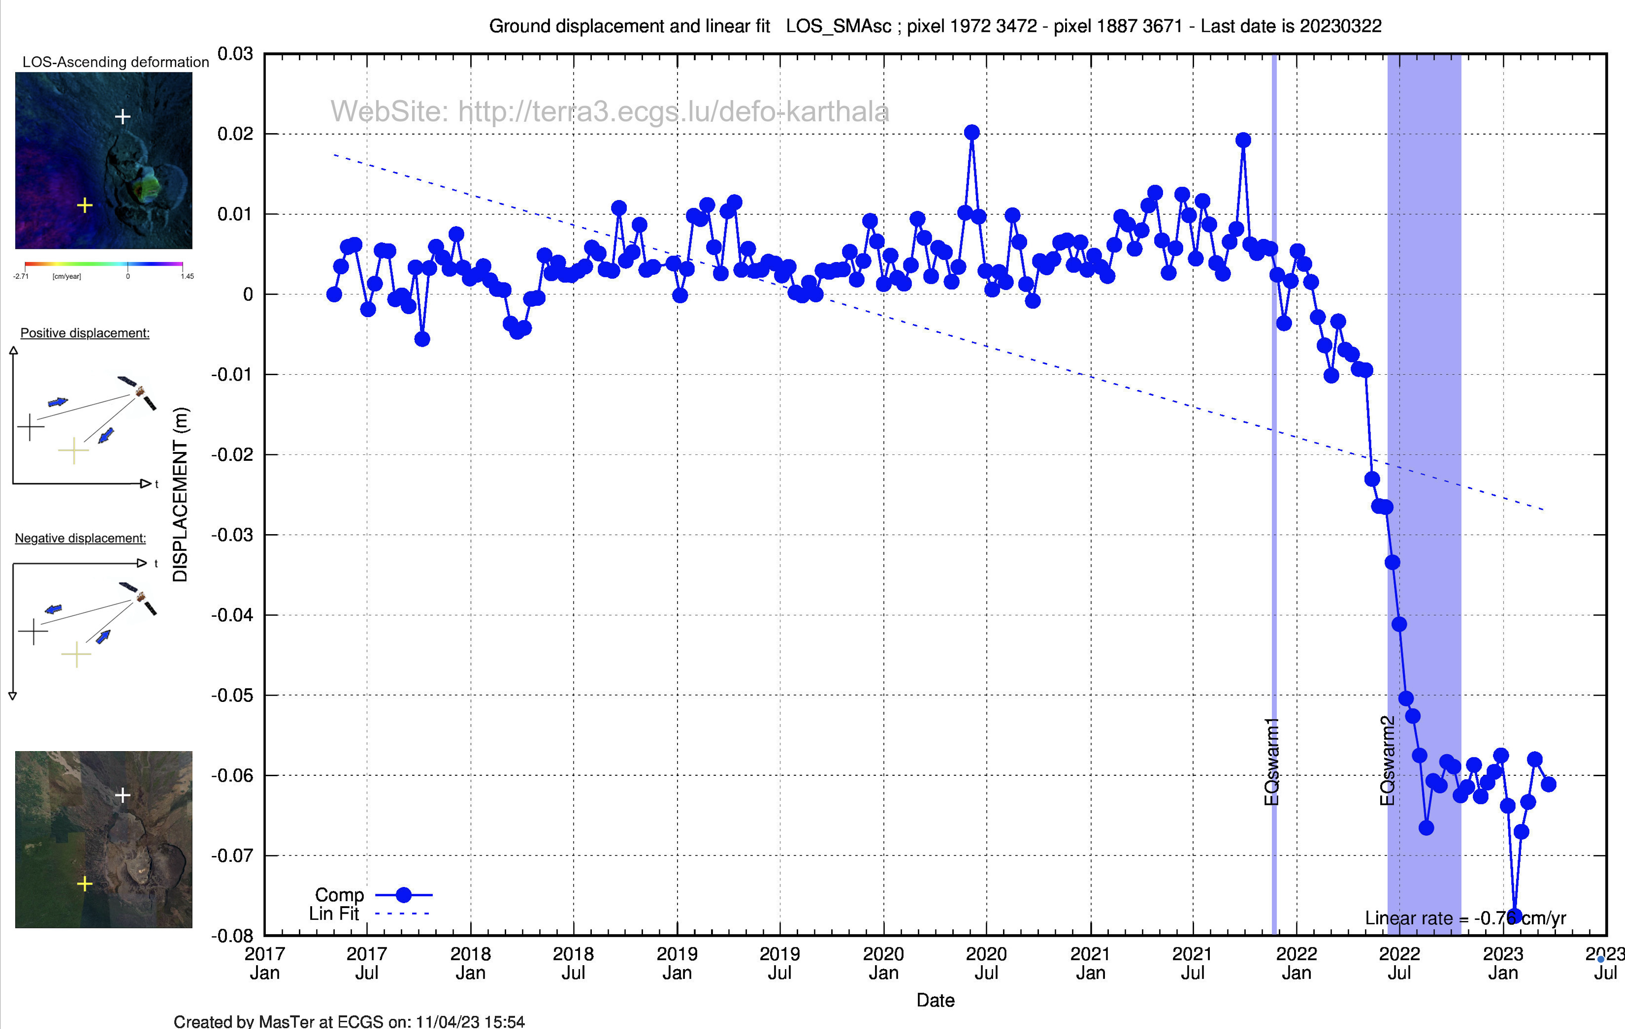
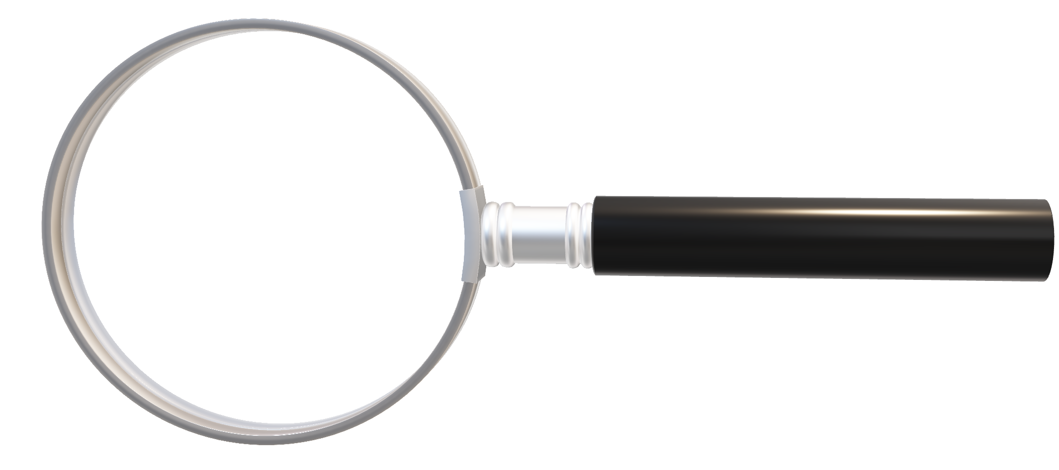
AMSTer Toolbox
Sat. image
Download
Web Page(s)
Interferometric processing
(AMSTer Engine)
Ampli.
Coh.
Time Series processing
(MSBAS)
Ampli.
Defo.
Mean Veloc.
Interf.
Cumul. defo.
Defo.
Time series
SuperMasterCoregistration.sh SuperMaster_MassProc.sh
G. Celli
D. Derauw
S. Samsonov
M. Jaspard
N. d’Oreye & D. Smittarello

Slide 4
Mass Processing & Exercise 2
Plan:
Building the baseline plot and selecting the Super Master:
lns_All_Img.sh
Prepa_MSBAS.sh
Dual criteria selection
Manually add or remove pairs from automated list
Note about old baseline plot tools
Coregistration on the Super Master:
SuperMasterCoreg.sh
__SplitCoreg.sh
Mass Processing:
SuperMaster_MassProc.sh
__SplitSession.sh
Additional information:
Note about updated S1 orbits
Verify_Mass_Process_Results.sh
Re-geocode or re-unwrap
Hands-on exercice 2 with data on Domuyo - Laguna del Maule

Slide 5
Exercise 2
Building the baseline plot and selecting the Super Master:
lns_All_Img.sh (must be run for each mode !):
Create a directory where to link all the images from the given mode to process, e.g. in …/1650/SAR_SM/MSBAS/YourRegion/seti where i is an index for each mode/sat of available data. In our case, YourRegion = ARGENTINE and i = 1-2
Although not mandatory, keep a note with all the modes for your convenience, e.g. in a file …/1650/SAR_SM/MSBAS/YourRegion/ _Sets_description.txt that contains e.g.:
Syntax : in /set1 dir lns_All_Img.sh WhereDataAre/NoCrop WhereDataSet SAT where WhereDataSet/NoCrop is e.g. $PATH_1650/SAR_CSL/S1/ARG_DOMU_LAGUNA_A_18/NoCrop WhereDataSet is e.g. $PATH_1650/SAR_SM/MSBAS/ARGENTINE/set1 SAT is S1
Do the same for Descending in /set2dir : where WhereDataAre/NoCrop is e.g. $PATH_1650/SAR_CSL/S1/ARG_DOMU_LAGUNA_D_83/NoCrop WhereDataSet is e.g. $PATH_1650/SAR_SM/MSBAS/ARGENTINE/set2 SAT is S1
Note: for the sake of efficiency for the exercice, the provided CSL data only contains images.csl/Info + dir names
Description for Argentine processings:
set1 = S1 Domuyo & Laguna del Maule Asc 18
set2 = S1 Domuyo & Laguna del Maule Desc 83
set3 = SAOCOM Asc
set4 = …

Slide 6
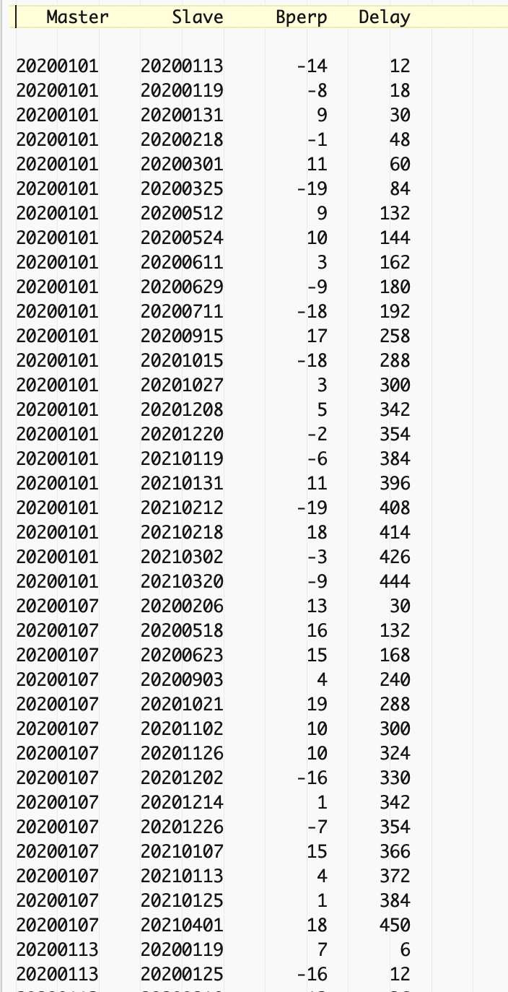
Exercise 2
Building the baseline plot and selecting the Super Master:
lns_All_Img.sh
Prepa_MSBAS.sh (must be run for each mode !):
Because it is the first run, you do not have a Super Master yet. Hence run Prepa_MSBAS.sh WhereDataSet BP BT where WhereDataSet is $PATH_1650/SAR_SM/MSBAS/ARGENTINE/set1 and [same]/set2 BP is e.g. 20 BT is e.g. 450 and answer y when it asks you if you want to compute a new Super Master
At second run, you do not want to recompute a Super Master, (because you would have to re-coregister all the images on the new SM then compute again all the Mass Processed pairs !). Hence, at next runs add a 4th parameter with the date of the former Super Master and answer n when it asks you if you want to compute a new Super Master…
In any case, you should end up with the following files:
A table with the list of pairs satisfying your criteria: table_0_20_0_450.txt

Slide 7
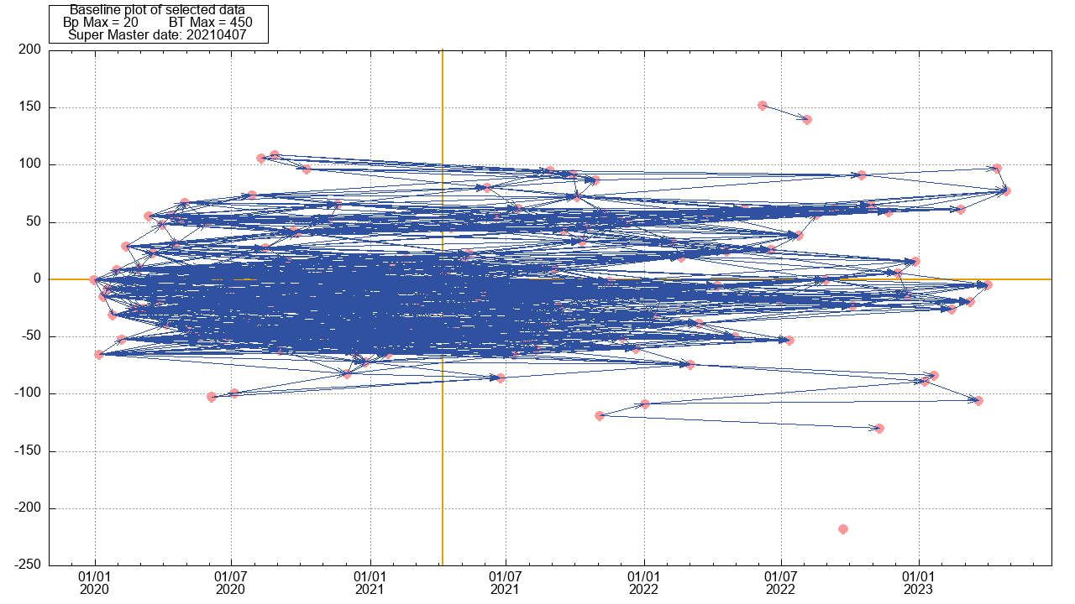
Exercise 2
Building the baseline plot and selecting the Super Master:
lns_All_Img.sh
Prepa_MSBAS.sh (must be run for each mode !):
Because it is the first run, you do not have a Super Master yet. Hence run Prepa_MSBAS.sh WhereDataSet BP BT where WhereDataSet is $PATH_1650/SAR_SM/MSBAS/ARGENTINE/set1 and [same]/set2 BP is e.g. 20 BT is e.g. 450 and answer y when it asks you if you want to compute a new Super Master
At second run, you do not want to recompute a Super Master, (because you would have to re-coregister all the images on the new SM then compute again all the Mass Processed pairs !). Hence, at next runs add a 4th parameter with the date of the former Super Master and answer n when it asks you if you want to compute a new Super Master…
In any case, you should end up with the following files:
A table with the list of pairs satisfying your criteria: table_0_20_0_450.txt
A baseline plot: baselinePlot_BpMax=20_BTMax=450.txt.png
See in that plot the selected (or forced) SM for the subset of images satisfying the baselines criteria.
Note that the SM indicated in allPairsListing.txt is the one for the whole data set, not the selected pairs.

Slide 8
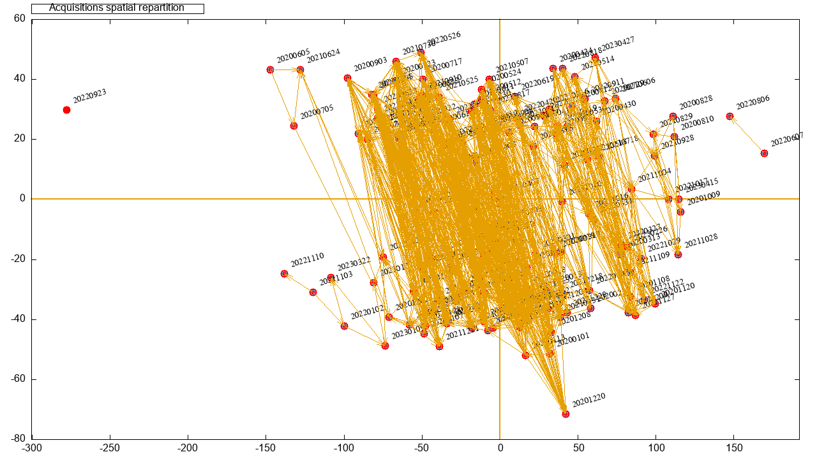
Exercise 2
Building the baseline plot and selecting the Super Master:
lns_All_Img.sh
Prepa_MSBAS.sh (must be run for each mode !):
Because it is the first run, you do not have a Super Master yet. Hence run Prepa_MSBAS.sh WhereDataSet BP BT where WhereDataSet is $PATH_1650/SAR_SM/MSBAS/ARGENTINE/set1 and [same]/set2 BP is e.g. 20 BT is e.g. 450 and answer y when it asks you if you want to compute a new Super Master
At second run, you do not want to recompute a Super Master, (because you would have to re-coregister all the images on the new SM then compute again all the Mass Processed pairs !). Hence, at next runs add a 4th parameter with the date of the former Super Master and answer n when it asks you if you want to compute a new Super Master…
In any case, you should end up with the following files:
A table with the list of pairs satisfying your criteria: table_0_20_0_450.txt
A baseline plot: baselinePlot_BpMax=20_BTMax=450.txt.png
A orbital plot: imageSatialLocalisation_BpMax=20_BTMax=450.txt.png

Slide 9
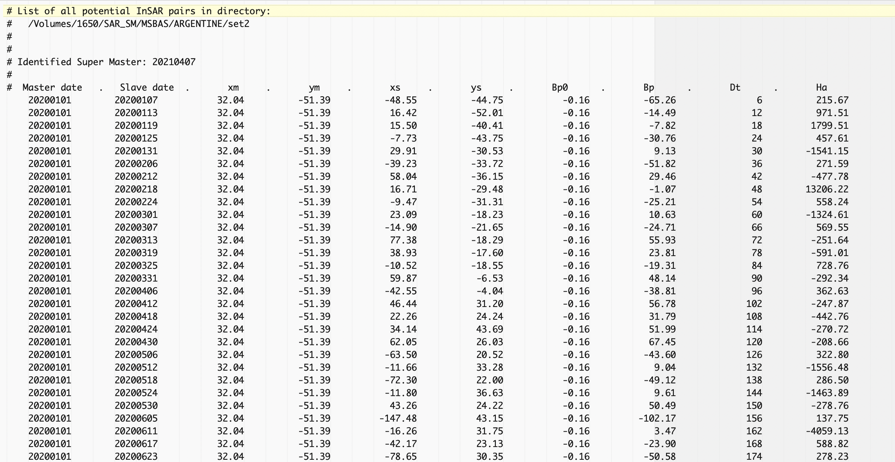
Exercise 2
Building the baseline plot and selecting the Super Master:
lns_All_Img.sh
Prepa_MSBAS.sh (must be run for each mode !):
Because it is the first run, you do not have a Super Master yet. Hence run Prepa_MSBAS.sh WhereDataSet BP BT where WhereDataSet is $PATH_1650/SAR_SM/MSBAS/ARGENTINE/set1 and [same]/set2 BP is e.g. 20 BT is e.g. 450 and answer y when it asks you if you want to compute a new Super Master
At second run, you do not want to recompute a Super Master, (because you would have to re-coregister all the images on the new SM then compute again all the Mass Processed pairs !). Hence, at next runs add a 4th parameter with the date of the former Super Master and answer n when it asks you if you want to compute a new Super Master…
In any case, you should end up with the following files:
A table with the list of pairs satisfying your criteria: table_0_20_0_450.txt
A baseline plot: baselinePlot_BpMax=20_BTMax=450.txt.png
A orbital plot: imageSatialLocalisation_BpMax=20_BTMax=450.txt.png
A file with all the pairs and their characteristics: allPairsListing.txt

Slide 10
Exercise 2
Building the baseline plot and selecting the Super Master:
lns_All_Img.sh
Prepa_MSBAS.sh (must be run for each mode !):
Because it is the first run, you do not have a Super Master yet. Hence run Prepa_MSBAS.sh WhereDataSet BP BT where WhereDataSet is $PATH_1650/SAR_SM/MSBAS/ARGENTINE/set1 and [same]/set2 BP is e.g. 20 BT is e.g. 450 and answer y when it ask you if you want to compute a new Super Master
At second run, you do not want to recompute a Super Master, (because you would have to re-coregister all the images on the new SM then compute again all the Mass Processed pairs !). Hence, at next runs add a 4th parameter with the date of the former Super Master and answer n when it ask you if you want to compute a new Super Master…
In any case, you should end up with the following files:
A table with the list of pairs satifying your criterias: table_0_20_0_450.txt
A baseline plot: baselinePlot_BpMax=20_BTMax=450.txt.png
A orbital plot: imageSatialLocalisation_BpMax=20_BTMax=450.txt.png
A file with all the pairs and their characteristics: allPairsListing.txt
Plus some intermediate files & files to be compatible with old version of the tools to build the plot.

Slide 11
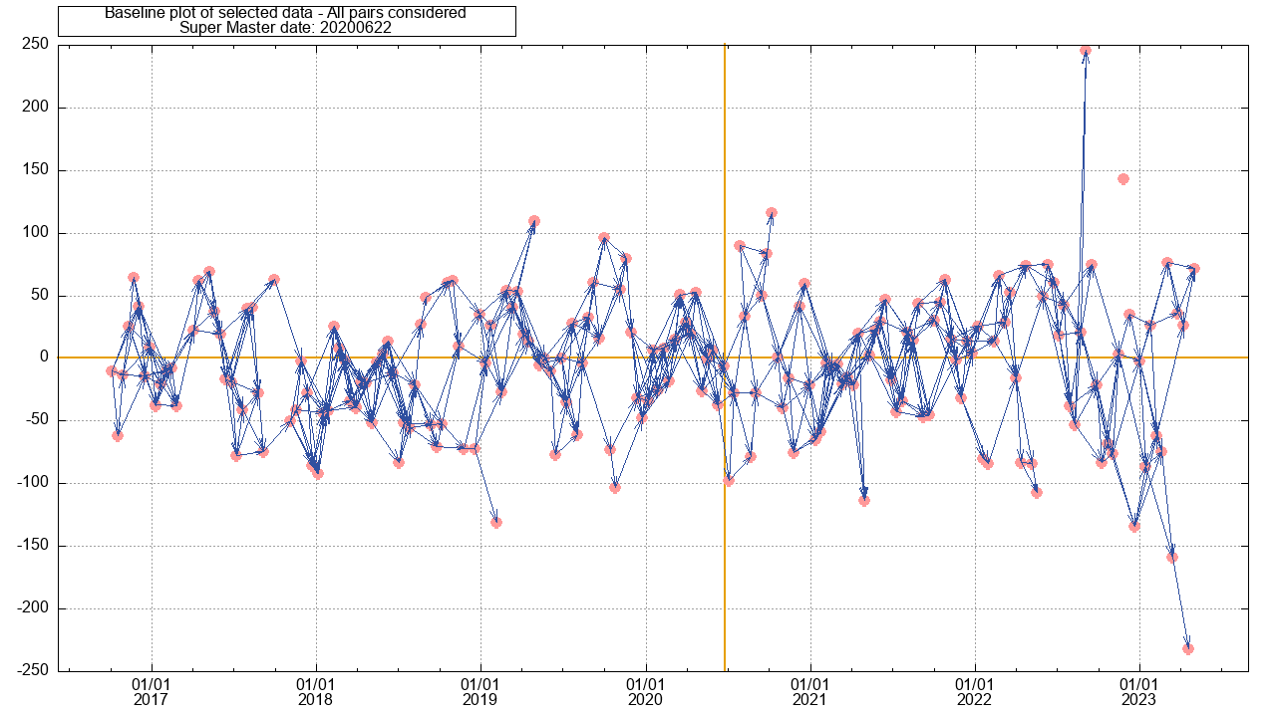
Exercise 2
Building the baseline plot and selecting the Super Master:
lns_All_Img.sh
Prepa_MSBAS.sh
Dual criteria selection
If you need to increase the baseline criteria from a given date, e.g. when the orbital tube is suddenly degraded such as after the loss of S1-B, you may ask Prepa_MSBAS.sh to use a second set of criteria from a given date as follow:
Prepa_MSBAS.sh WhereDataSet BP1 BT1 DATESM BP2 BT2 DATECHANGE where BP1 and BT1 are the baseline criteria for the first part of the time series DATESM is the date of the Super Master BP2 and BT2 are the baseline criteria for the second part of the time series DATECHANGE is the date from which it shoud use BP2 and BT2 to select the pairs
Illustrative example from Réunion Island: baseline Plot with BpMax=70 Before 20220501 then BpMax=90 After_20220501

Slide 12



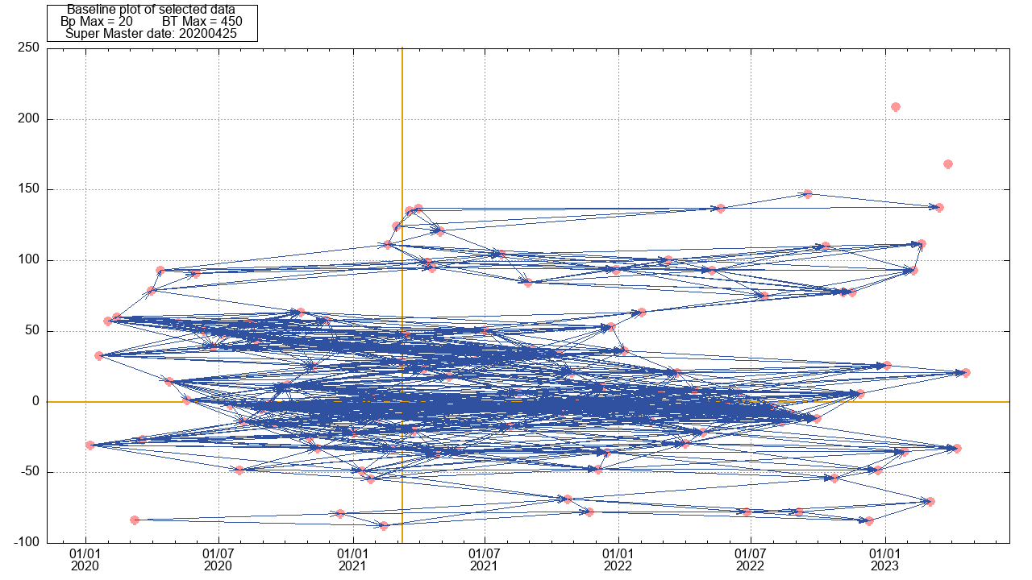

Exercise 2
Building the baseline plot and selecting the Super Master:
lns_All_Img.sh
Prepa_MSBAS.sh
Dual criteria selection
Manually add or remove pairs from automated list
To add pairs to the baseline plot that does not fit the criteria (e.g. to fill a gap without having to enlarge the criteria for the whole data base), you can add in a table table_0_MaxBp_0_MaxBt_AdditionalPairs.txt (where MaxBp and MaxBt are the same as those already used; beware of spelling !) containing a list of pairs in the form (no header; tab separated): DateMaster DateSlave Bp Bt These pairs will be added automatically to the baseline plot when running Prepa_MSBAS.sh. Test it e.g. by adding to set 1, the two pairs in table_0_20_0_450_AdditionalPairs.txt as follow: 20230329 20230422 147 24 20230410 20230422 53 12 (See also manual § 4.3)
Note a little bug (small offset to new pairs… see gnuplot file to sort it out)

Slide 13
Exercise 2
Building the baseline plot and selecting the Super Master:
lns_All_Img.sh
Prepa_MSBAS.sh
Dual criteria selection
Manually add or remove pairs from automated list
To add pairs to the baseline plot
To remove pairs from the baseline plot although they do fit the criteria, either:
Remove them from the desired list of pairs file. Ensure that the link selectedPairsListing.txt points toward that file, then re-run the gnuplot scripts: gnuplot baselinePlot.gnuplot (must be launched in in seti directory of course)
Or remove lines in the Table_Bmin_Bmax_Tmin_Tmax.txt file, Launch the script plotBaselines.sh. The plot will however be in another format and named span_FlatArrow _0_MaxBp_0_MaxBt.eps (see manual § 4.3, page 84)
Or do it when building time series data sets (see manual § 6.1a page 104): add a file named _EXCLUDE_PAIRS_ALTHOUGH_CRITERIA_OK.txt in the directroy of the mode to invert using msbas (DefoInterpolx2Detrendi; see exercice 3), then run Exclude_Pairs_From_Mode.txt.sh, then PlotBaselineGeocMSBASmodeTXT.sh (see manual § 6.5).

Slide 14
Exercise 2
Building the baseline plot and selecting the Super Master:
lns_All_Img.sh
Prepa_MSBAS.sh
Dual criteria selection
Manually add or remove pairs from automated list
Note about old baseline plot tools
For the sake of compatibility with former versions of MasTer, there are some old tools used to build baseline plots (build_bperp_file.sh and plotBaselines.sh - see manual §4.3).
These require files that are still prepared by Prepa_MSBAS.sh although they are not used by usual MasTer features. These files (stored in …/SAR_SM/MSBAS/YourRegion/seti ) are e.g. :
span_0_MaxBp_0_MaxBt.txt
Span1_0_MaxBp_0_MaxBt.txt
Bperp_file.txt
They can be ignored most of the time except if for any reason you want to create baseline plots with these older tools (plotBaselines.sh)

Slide 15
Exercise 2
Building the baseline plot and selecting the Super Master:
lns_All_Img.sh
Prepa_MSBAS.sh
Dual criteria selection
Manually add or remove pairs from automated list
Note about old baseline plot tools
Extract_x_Shortest_Connections.sh
This script prepares a table named table_0_0_MaxShortest_x.txt with all the pairs with the x shortest connections in the baseline plot. It computes this from the file allPairsListing.txt (created with Prepa_MSBAS.sh) from the current directory. See manual § 4.3, page 85

Slide 16
Exercise 2
Building the baseline plot and selecting the Super Master:
lns_All_Img.sh
Prepa_MSBAS.sh
Dual criteria selection
Manually add or remove pairs from automated list
Note about old baseline plot tools
Extract_x_Shortest_Connections.sh
DelaunayTable.sh
This script prepares a table named table_0_0_DelaunayPARAM_0.txt (where PARAM is RatioxxxMaxBtxxxMaxBpxxx ; see below) with all the pairs in the baseline plot satisfying a Delaunay triangulation, and a possible filtering of the baselines larger than a maximum temporal and/or spatial baseline provided as parameters. The script computes this selection thanks to the file allPairsListing.txt (created with Prepa_MSBAS.sh) from the current directory. It takes 3 optional parameters (in any order):
-Ratio=float: where float is a number (as float format) representing the ratio between X axis (time; in years) and Y axis (Bp in meters) in the Delaunay plot. For instance, a ratio of x will make the 1m baseline orthogonal to 1 day/x. Adjusting that ration allows avoiding elongated triangles;
-BpMax=integer: the Max Bp (as integer format) allowed for the segments of the triangles in y direction;
-BtMax=integer: the Max Bt (as integer format) allowed for the segments of the triangles in x direction.

Slide 17
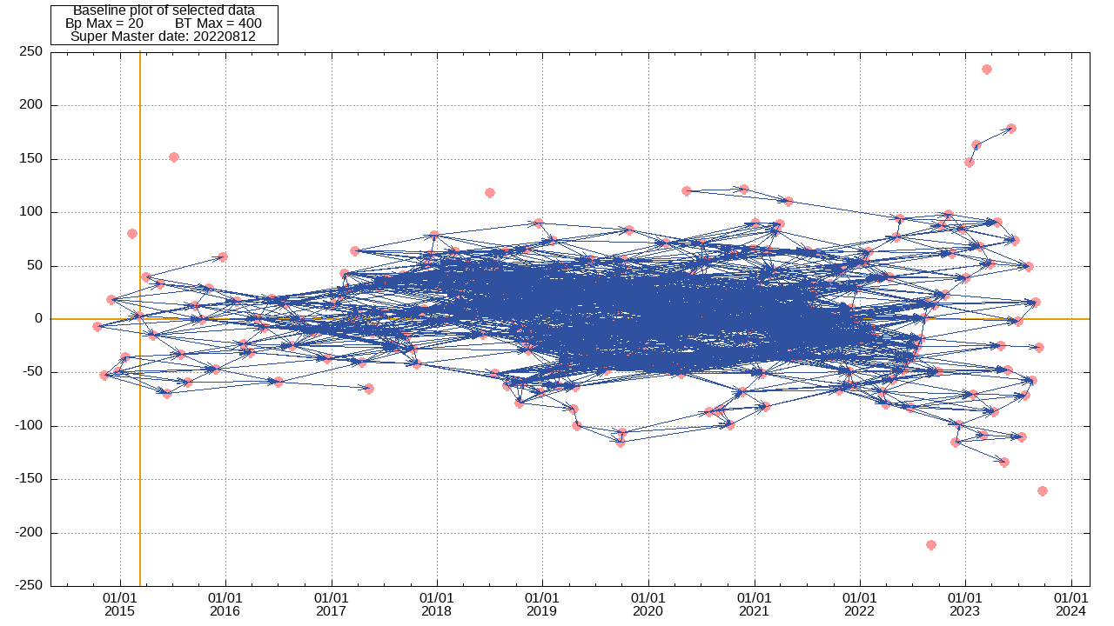
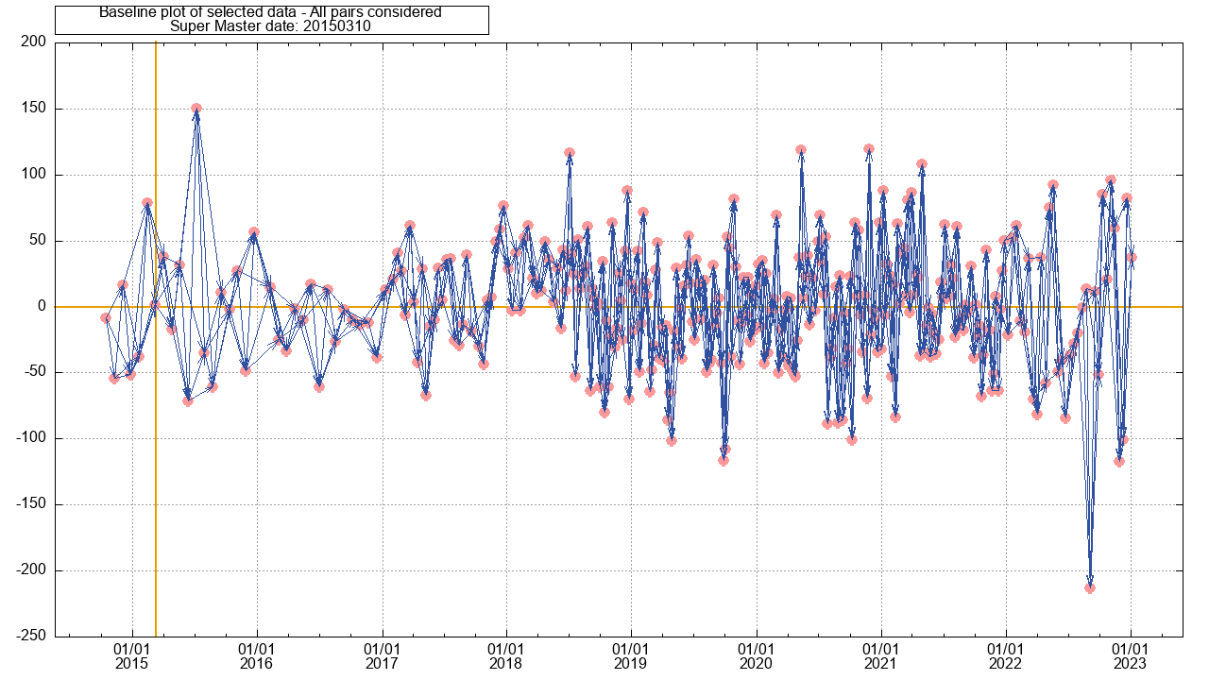
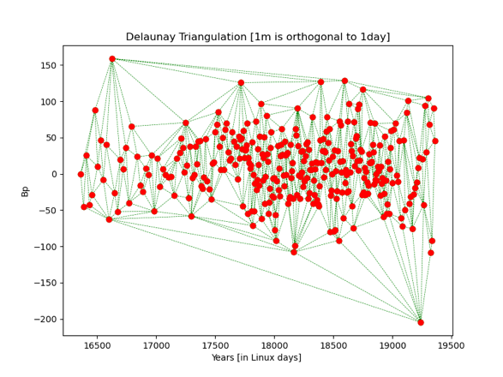
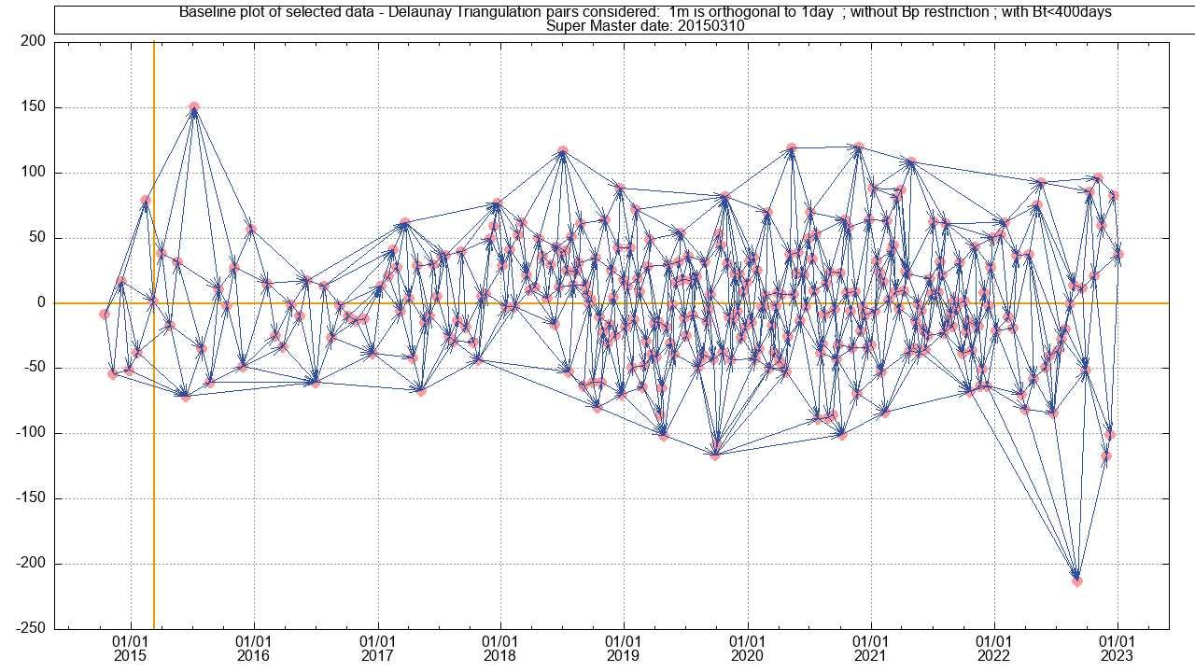
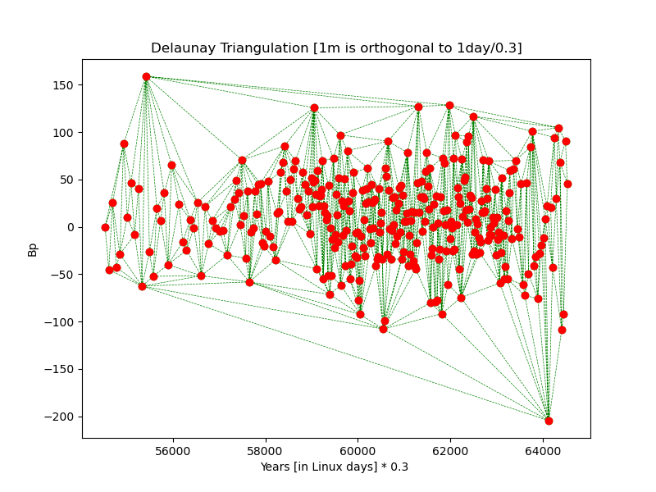
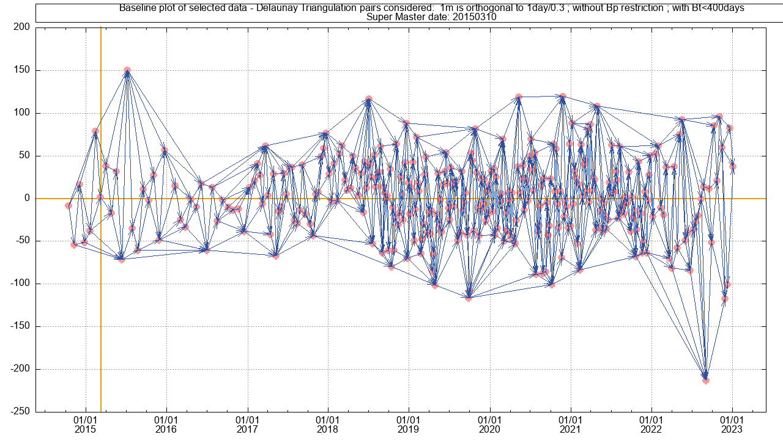
Exercise 2
Building the baseline plot and selecting the Super Master:
lns_All_Img.sh
Prepa_MSBAS.sh
Dual criteria selection
Manually add or remove pairs from automated list
Note about old baseline plot tools
Extract_x_Shortest_Connections.sh
DelaunayTable.sh
Example of baseline plot for Sentinel 1 images acquired in the Virunga (DRC) computed with several techniques:
Top Left: All pairs with Bp <20m and Bt < 400 days (obtained with prepa_MSBAS.sh). Top Right: Max 3 shortest connection (obtained with Extract_x_Shortest_Connections.sh).
Middle Left: Delaunay Triangulation without Ratio (i.e. 1m is orthogonal to 1 day)
and without maximum baseline filtering.
Middle right: Same as above with spatial baseline restricted to Max 400 days (both obtained with DelaunaTable.sh).
Bottom Left: Delaunay Triangulation with Ratio 0.3 (i.e. 1m is orthogonal to 1/.3 day) and without maximum baseline filtering.
Bottom right: Same as above with spatial baseline restricted to Max 400 days (both obtained with DelaunaTable.sh).
(Note: The top left baseline plot covers a slightly longer time span)

Slide 18
Exercise 2
Building the baseline plot and selecting the Super Master
Coregistration on the Super Master:
SuperMasterCoreg.sh: That step must always be run, though it will do different things depending on the satellite/mode:
For all satellites/modes but S1 in IW, it coregisters (i.e. aligns) each image on the Super Master. Hence the script will:
First compute the DEM (and maybe the mask) - if required - in the slant range geometry of the Super Master,
Compute the affine transformation to coregister and resample each image in the slant range geometry of the Super Master.
For Sentinel 1 in Wide Swath mode (IW), because of the TOPSAR acquisition principle, all the images of a given mode are already aligned. There is no need to coregister each image in the geometry of the Super Master and any image can be used as a master in its own slant range geometry. Hence the script will:
compute the DEM (and maybe the mask) - if required - in the slant range geometry for each image.

Slide 19
Exercise 2
Building the baseline plot and selecting the Super Master
Coregistration on the Super Master:
SuperMasterCoreg.sh:
Syntax (see manual § 5.1)
SuperMasterCoreg.sh LaunchMasTerParam.txt [FORCE]
It will create a directory for each set where it will store the coregistration and resampling of each image to the SuperMaster. Its naming is as follow: …/SAR_SM/SAR_RESAMPLED/SAT/REGION_TRACK/SMCrop_SM_DATESM_CROPNAME_
Notes:
The script is incremental: it processes only the images that are not coregistered yet.
It computes the DEM only if it does not exist yet. (For S1 IW, you can force to recompute the DEM for each image by adding FORCE as 2nd parameter).
It computes the mask only if required and if it does not exist yet.
Because for the sake of efficiency and security, SuperMasterCoreg.sh runs in a processing directory that is not the final one (cfr LaunchMTparam.txt), the script also runs RenamePathAfterMove.sh (and maybe RenamePath_Volumes.sh) after in order to set the final destination directory path in parameters files of each processed pairs (see manual § 5.1 - notes).

Slide 20
Exercise 2
Building the baseline plot and selecting the Super Master
Coregistration on the Super Master:
SuperMasterCoreg.sh
__SplitCoreg.sh
To speed up the coregistration processing, launch several SuperMasterCoreg.sh sessions in parallel in separate terminals using __SplitCoreg.sh.
The script must be provided with (see manual § 5.2):
A list of images to coregister and to be split
The LaunchMTparameters.txt file (with its full path) to be used
The number of parallel sessions to process the coregistration
If FORCE is provided as 4th parameter (for S1 images IW), it will recompute the DEM for each image
Beware: hard coded lines must be tuned in the script for locating the discs where one can compute the different sessions.

Slide 21
Exercise 2
Building the baseline plot and selecting the Super Master
Coregistration on the Super Master:
To practice, let’s coregister few S1 –IW images for the region of Domuyo – Laguna del Maule
Prepare a LaunchMTparam_S1_Arg_Domu_Laguna_D_83_Z1_ML8_MassProcess_Coreg.txt :
TRKDIR = ARG_DOMU_LAGUNA_D83_Tst_Coreg (because that is where the data are in …/SAR_CSL/S1)
SUPERMASTER = 20210407 (because that is what was discovered by Prepa_MSBAS.sh)
DEMNAME = NQNyMas (because that its name in DataSAR/SAR_AUX_FILES/DEM/SRTM30/ALL/)
CROP = CROPno & REGION = Domuyo_Laguna (or any other that makes sense to you)
INTERFML = 8
POWSPECSMOOTHFACT = 0 (because we are not interested in filtered interf. and it will spare time)
APPLYMASK = APPLYMASKno
And/or compare with provided DataSAR/SAR_AUX_FILES/Param_files/S1/ARG_DOMU…/ LaunchMTparam_S1_Arg_Domu_Laguna_D_83_Z1_ML8_MassProcess_Coreg.txt
run
SuperMasterCoreg.sh LaunchMTparam.txt FORCE (FORCE = in case wrong DEM already exist in SAR_CSL/S1/ARG_DOMU_LAGUNA_D83_Tst_Coreg/NoCrop/img.csl/Data)

Slide 22
Exercise 2
Building the baseline plot and selecting the Super Master
Coregistration on the Super Master:
To practice, let’s coregister few S1 –IW images for the region of Domuyo – Laguna del Maule
Prepare a LaunchMTparam_S1_Arg_Domu_Laguna_D_83_Z1_ML8_MassProcess_Coreg.txt :
Run
Check your results in …/1650/SAR_SM/RESAMPLED/S1/ARG_DOMU_LAGUNA_D83_Tst_Coreg/SMNoCrop_SM20210427/pairs
and
…/1650/SAR_CSL/S1/ARG_DOMU_LAGUNA_D83_Tst_Coreg/NoCrop/images.csl/Data/externalSlantRangeDEM …/1650/SAR_CSL/S1/ARG_DOMU_LAGUNA_D83_Tst_Coreg/NoCrop/images.csl/Info/externalSlantRangeDEM.txt

Slide 23
Exercise 2
Building the baseline plot and selecting the Super Master
Coregistration on the Super Master
Mass Processing:
SuperMaster_MassProc.sh
It will compute each interferometric pairs from a provided list in a directory …/PROCESS/AS/SAT/MAS_SLV
It will then move them in the final destination directory, that is …/SAR_MASSPROCESS/SAT/REGION_TRACK/SMCrop_SM_DATESM_CROPNAME/
As soon as a pair is processed, it will also move the geocoded products in a Geocoded directory located in the final destination directory, in subdirectories named by their type: …/SAR_MASSPROCESS/SAT/REGION_TRACK/SMCrop_SM_DATESM_CROPNAME/Geocoded/Ampli /Coh /Defo /DefoInterpol /DefoInterpolDetrend /DefoInterpolx2Detrend /InterfFilt /InterfResid /UnwrapPhase

Slide 24
Exercise 2
Building the baseline plot and selecting the Super Master
Coregistration on the Super Master
Mass Processing:
SuperMaster_MassProc.sh
Note that if the PROCESS directory is not on the same hard disc as the Geocoded directory, it will copy instead of move the pair directories and only erase them from PROCESS when all the pairs are processed and when it has confirmed that everything was copied to the final directory. This prevents losing results in case of connection loss between discs.
In a similar way, it will copy the rasters (quicklook .ras) of the geocoded products in a GeocodedRasters directory located in the final destination directory, in subdirectories named by their type. These quicklooks also remain in the pair directories.
Syntax (see manual § 5.3)
SuperMaster_ MassProc.sh ListOfPairs LaunchMTparam.txt [-f or -list=filename ] where ListOfPairs is a list of pairs to process (see e.g. table_0_BP_0_BT.txt computed by Prepa_MSBAS.sh) -f or -list=filename are optional to force a different type of list of pairs (see manual § 5.)

Slide 25
Exercise 2
Building the baseline plot and selecting the Super Master
Coregistration on the Super Master
Mass Processing:
SuperMaster_MassProc.sh
__SplitSession.sh
To speed up the mass processing, launch several SuperMaster_MassProc.sh sessions in parallel in separate terminals using __SplitSession.sh.
The script must be provided with (see manual § 5.4):
A list of pairs to process and to be split (see table_0_BP_0_BT.txt computed by Prepa_MSBAS.sh)
The LaunchMTparameters.txt file (with its full path) to be used
The number of parallel sessions to process the DInSAR
A 4th parameter can be offered for undocumented option – see script for explanations
Beware: hard coded lines must be tuned in the script for locating the discs where one can compute the different sessions.

Slide 26
Exercise 2
Building the baseline plot and selecting the Super Master
Coregistration on the Super Master
Mass Processing:
To practice, let’s process few S1 – IW pairs for the region of Laguna del Maule
Prepare a LaunchMTparam_S1_Arg_Domu_Laguna_D_83_Z1_ML8_MassProcess.txt :
TRKDIR = ARG_DOMU_LAGUNA_D83_Tst_Coreg (because that is where the data are in …/SAR_CSL/S1)
SUPERMASTER = 20210407 (because that is what was discovered by Prepa_MSBAS.sh)
DEMNAME = NQNyMas (because that its name in DataSAR/SAR_AUX_FILES/DEM/SRTM30/ALL/)
CROP = $PATH_1650/kml/ARGENTINA/Lagunal_Maule.kml Remember: cropping a S1 IW needs a kml; any other needs coordinates. See manual §3.1, note 2) page 69 !
REGION = Laguna_del_Maule (or any other that makes sense to you – no white space nor fancy characters!)
INTERFML = 8
POWSPECSMOOTHFACT = 1 (because we are not interested in filtered interf. and it will spare time)
APPLYMASK = APPLYMASKno
SKIPUW = SKIPyes (Tio spare time…)
And/or compare with provided DataSAR/SAR_AUX_FILES/Param_files/S1/ARG_DOMU…/ LaunchMTparam_S1_Arg_Domu_Laguna_D_83_Z1_ML8_MassProcess.txt

Slide 27
Exercise 2
Building the baseline plot and selecting the Super Master
Coregistration on the Super Master
Mass Processing:
To practice, let’s process few S1 – IW pairs for the region of Laguna del Maule
Prepare a LaunchMTparam_S1_Arg_Domu_Laguna_D_83_Z1_ML8_MassProcess.txt :
run
SuperMaster_MassProc.sh with the following parameters : …/SAR_SM/MSBAS/ARGENTINE/set2/table_0_20_0_450_SAMPLE_FOR_TST.txt
LaunchMTparam_S1_Arg_Domu_Laguna_D_83_Z1_ML8_MassProcess.txt
➔ OK? ✅ (~ 1 min for DEM + 25 min or with unwrapping) See in …/SAR_MASSPROCESS/S1/…

Slide 28
Exercise 2
Building the baseline plot and selecting the Super Master
Coregistration on the Super Master
Mass Processing:
To practice, let’s process few S1 – IW pairs for the region of Laguna del Maule
What do you see at the Terminal ?
Ask you to be sure…
Suggest to process 3 pairs
Process (at least on the first run) to the DEM projection in Slant Range
Crash on first pair, as expected 😇. Why ? (also look in your PROCESS directory: what is wrong and why ?)
See if it successfully moved everything to /SAR_MASSPROCESS/
Tells you everything is done…

Slide 29
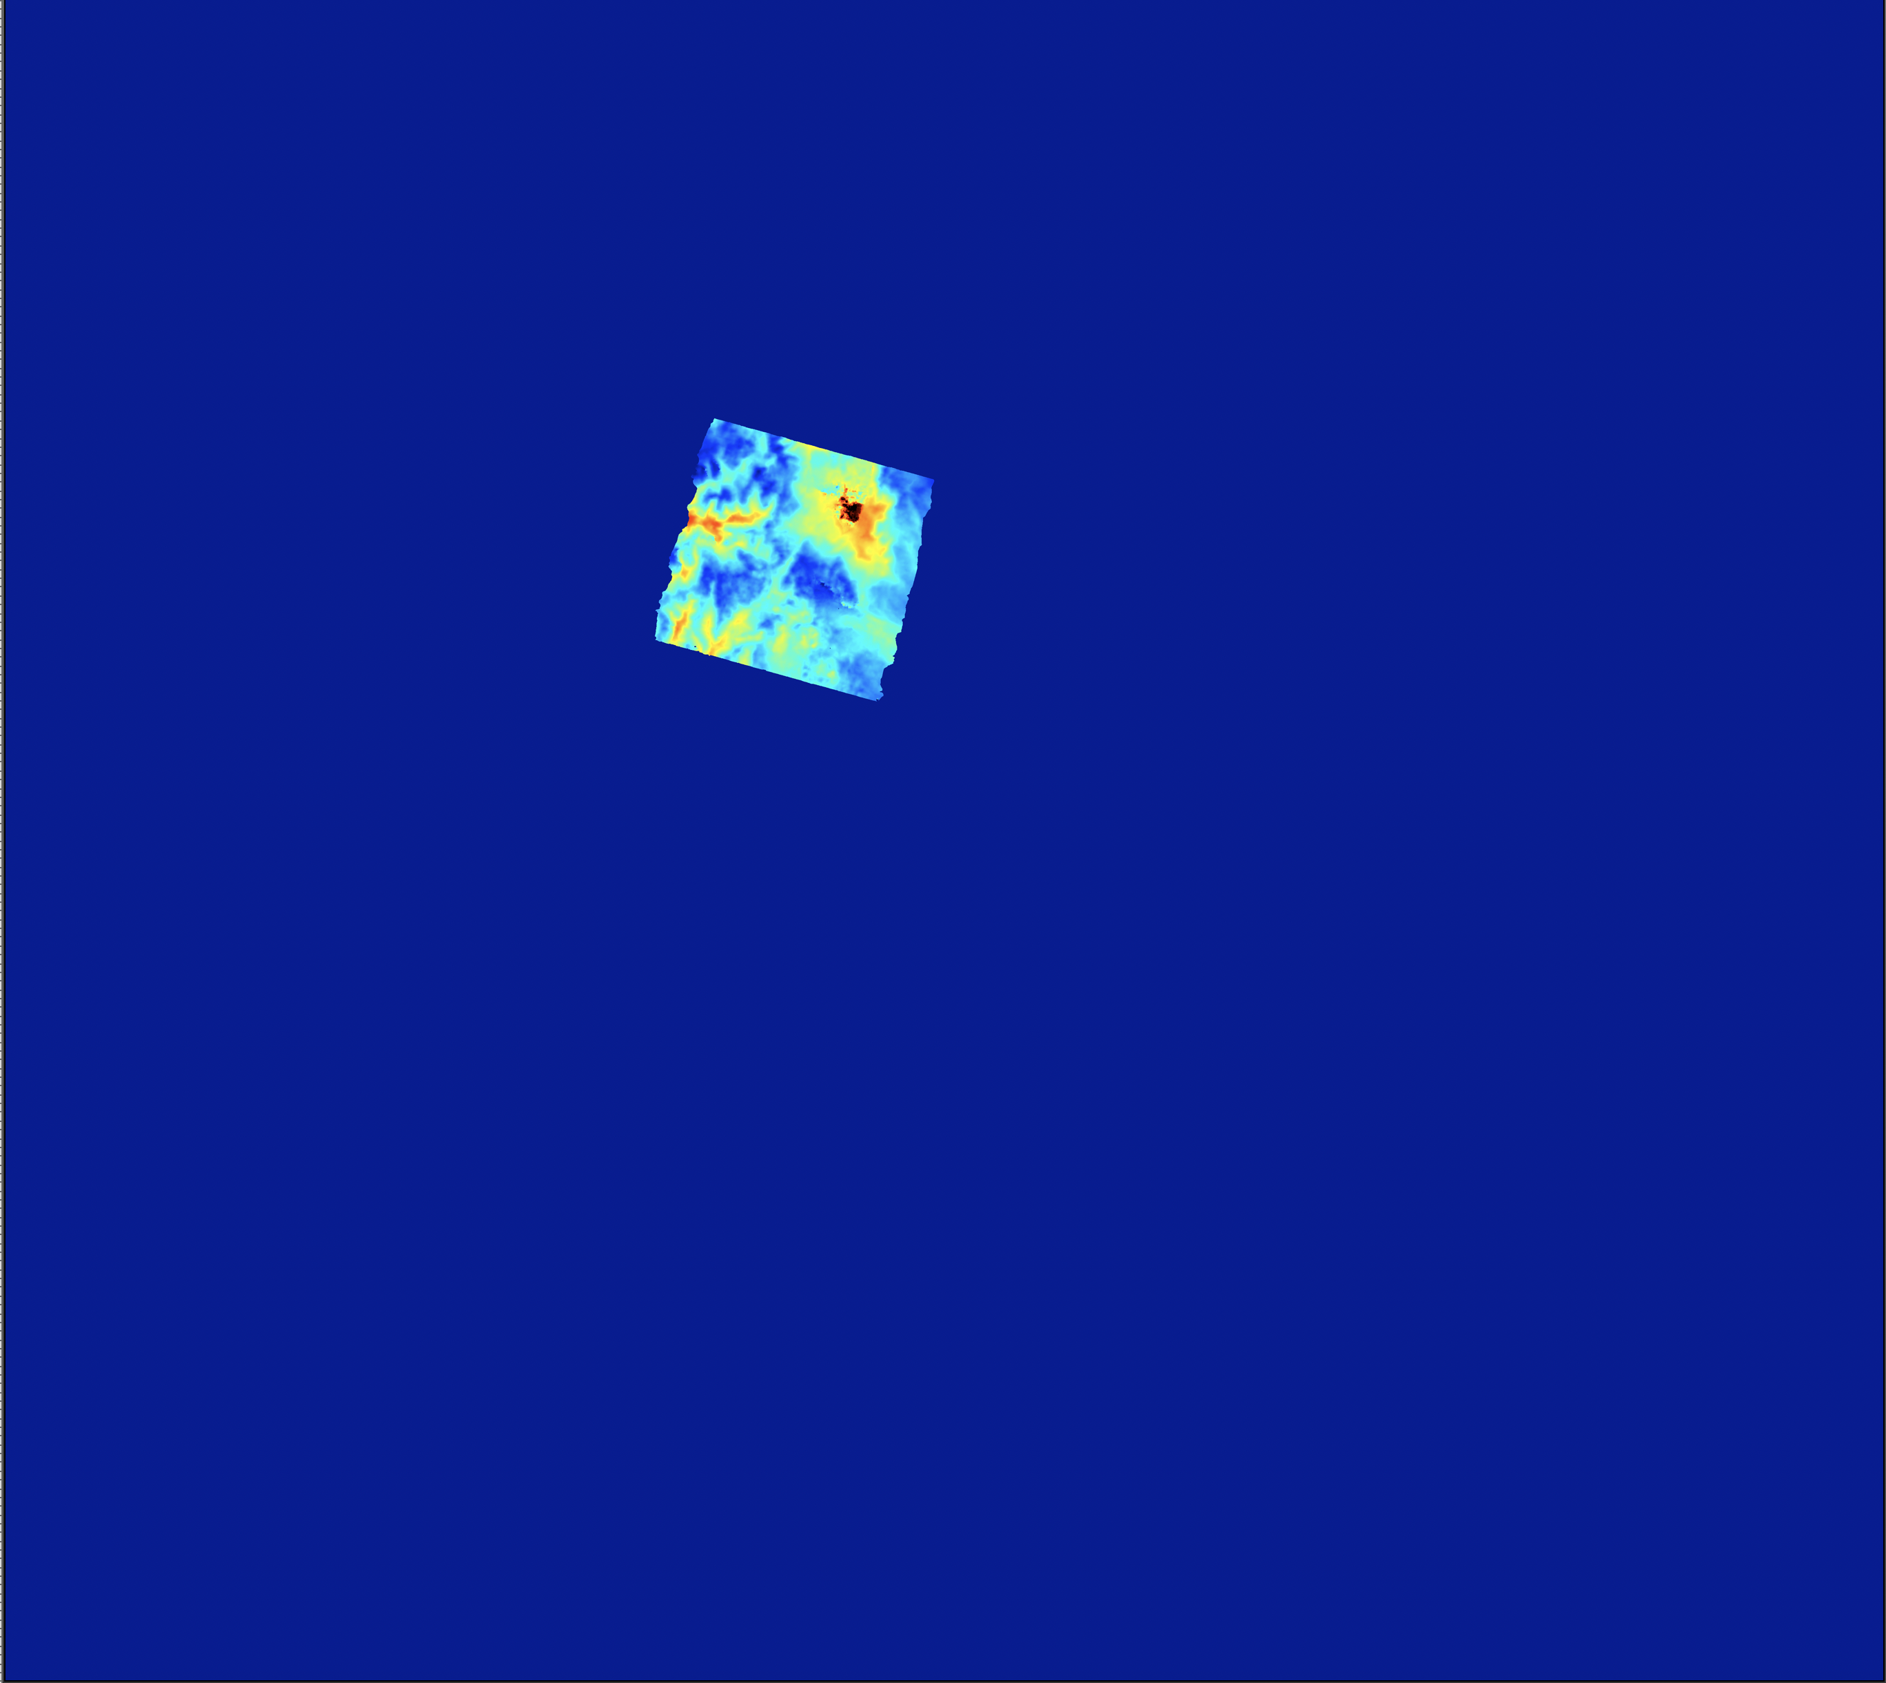
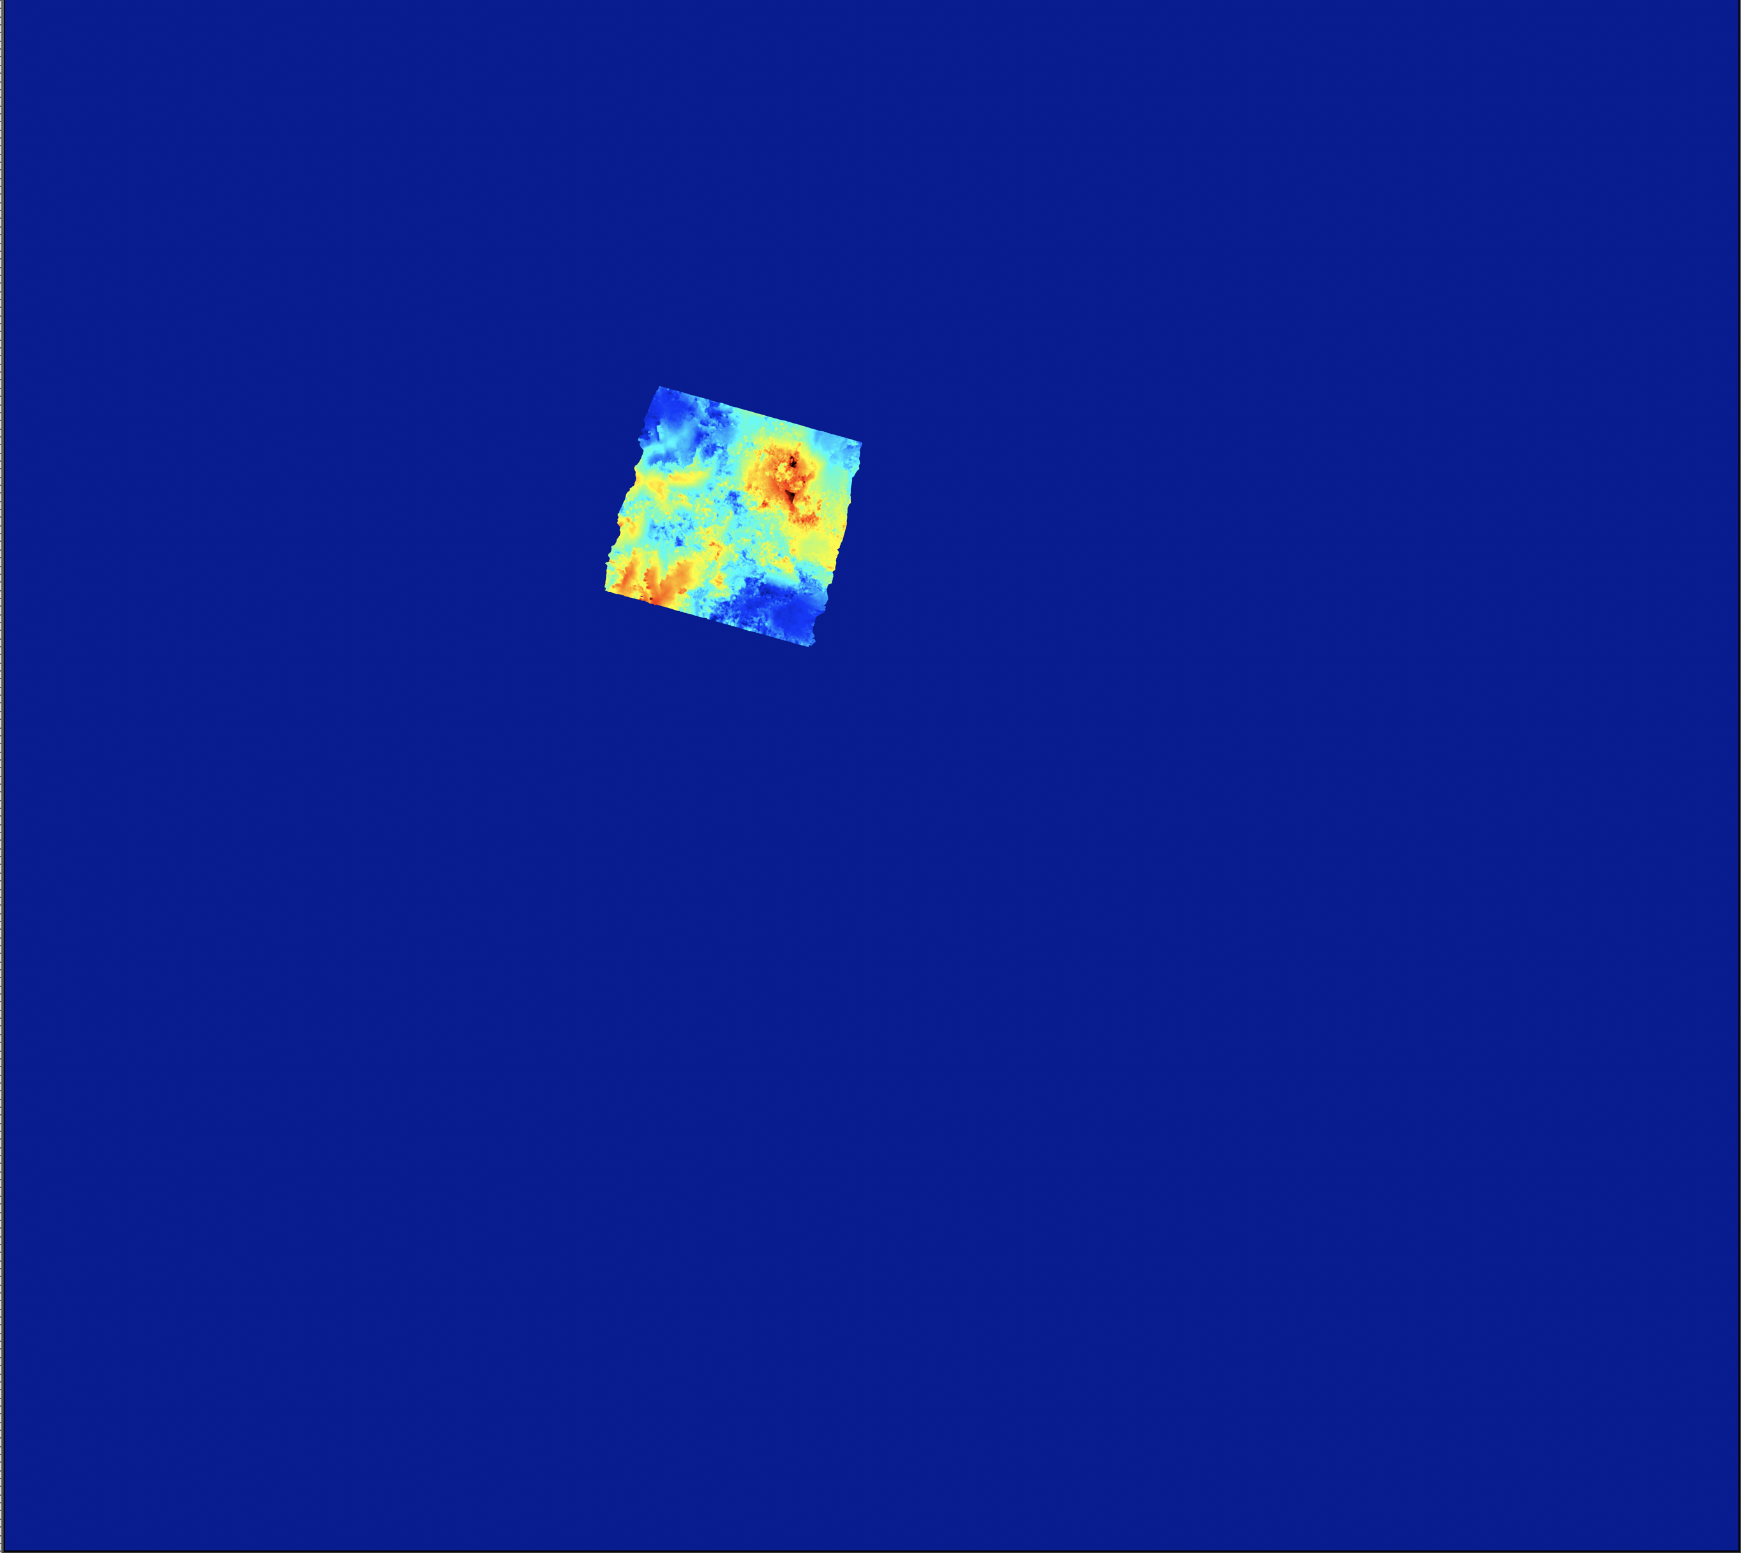
Exercise 2
Building the baseline plot and selecting the Super Master
Coregistration on the Super Master
Mass Processing:
To practice, let’s process few S1 – IW pairs for the region of Laguna del Maule
Results: e.g. in …/3601/SAR_MASSPROCESS/S1/ARG_DOMU_LAGUNA_D_83_Tst_Coreg/SMNoCrop_SM_20210407_Zoom1_ML8/GeocodedRasters/DefoInterpolx2Detrend
deformationMap.interpolated.flattened.UTM.50x50.bil.interpolated_S1_ARG_DOMU_LAGUNA_D_83_Tst_Coreg-36.2deg_20210407_20210413_Bp8.903m_HA-1720m_BT6days_Head253.6deg.ras
deformationMap.interpolated.flattened.UTM.50x50.bil.interpolated_S1_ARG_DOMU_LAGUNA_D_83_Tst_Coreg-36.2deg_20210407_20210507_Bp16.77m_HA-897.m_BT30days_Head253.6deg.ras

Slide 30
Exercise 2
Building the baseline plot and selecting the Super Master
Coregistration on the Super Master
Mass Processing
Additional information:
Note about updated S1 orbits (See manual § 2)
When perform the reading of the data with Read_All_Img.sh, it will search of course if new images were made available
It also check if updated orbits were made available. (Note that it only checks for the most recent ones unless you added the parameter ForceAllYears. Also, it does not attempt to update the orbits at all if you added the parameter –n).
If orbits were updated, and if you have launched Read_All_Img.sh with the parameters /SAR_SM/RESAMPLED/ /SAR_MASSPROCESS/ it will move all products computed with the preliminary orbits into dedicated directories: /SAR_SM/RESAMPLED/S1_CLN /SAR_MASSPROCESS/S1_CLN Hence, next time you run a SuperMasterCoreg.sh and/or SuperMaster_MassProc.sh, it will recompute these products with the updated orbits.
These S1_CLN directories are flushed after 30 days to avoid overloading your hard disks.

Slide 31
Exercise 2
Building the baseline plot and selecting the Super Master
Coregistration on the Super Master
Mass Processing
Additional information:
Verify_Mass_Process_Results.sh (see manual § 5.6):
When you are done with a mass processing, you may wonder if everything is OK. Or you may face problem at the time series inversion because some deformation data are missing or corrupted.
To assist you to identify where it could have been going wrong , you can run the script Verify_Mass_Process_Results.sh with the following 2 parameters:
PairsFile.txt (path to file with the list of compatible pairs, i.e. …/SAR_SM/MSBAS/REGION/seti/table_0_MaxBp_0_MaxBt.txt)
MASSPROCESSINGPATH (path to where geocoded products are stored, i.e. …/SAR_MASSPROCESS/SAT/TRACK/CROP_SM_DATE_ZOOM_ML/Geocoded)
It will check if all pairs are processed and each geocoded product is stored as expected in /Geocoded…. Missing products will be listed in files. It will also offer to clean incoherent occurrence of files and pair directories (beware…).

Slide 32
Exercise 2
Building the baseline plot and selecting the Super Master
Coregistration on the Super Master
Mass Processing
Additional information:
Re-geocode or re-unwrap a list of pairs in SAR_MASSPROCESS (see manual § 8.5)
If results were moved from PROCESS to SAR_MASSPROCESS, first run in …/SAR_MASSPROCESS/SAT/TRACK/CROP_SM_DATE_ZOOM_ML the script RenamePathAfterMove_in_SAR_MASSPROC.sh SAT
In the same directory, run ReUnwrap_fromList.sh with a list of pairs to reprocess in one column, as MAS_SLV dates (or S1 names) and the parameters file for that re-run. Test it for instance by changing the parameter ZONEMAP as ZoneMapYes.
In the same directory, run ReGeocode_fromList.sh with a list of pairs to reprocess in one column, as MAS_SLV dates (or S1 names) and a parameters file for that re-run. Note that the list of products to re-geocode is hard coded in the script, as well as the option to recompute the raster figures. You can change all that…

Slide 33
Exercise 2
Building the baseline plot and selecting the Super Master:
lns_All_Img.sh
Prepa_MSBAS.sh
Dual criteria selection
Manually add or remove pairs from automated list
Note about old baseline plot tools
Extract_x_Shortest_Connections.sh
DelaunayTable.sh
Coregistration on the Super Master:
SuperMasterCoreg.sh
__SplitCoreg.sh
Mass Processing:
SuperMaster_MassProc.sh
__SplitSession.sh
Additional information:
Note about updated S1 orbits
Verify_Mass_Process_Results.sh
Re-geocode or re-unwrap
- DONE ! -

Slide 34
Data samples for exercise 3
Provide samples to participants
Directory with mass processed DInSAR pairs: 3601/SAR_MASSPROCESS/S1/ARG_DOMU_LAGUNA_A_18_SAMPLE 144.19 Gb – 16.204 items 3601/SAR_MASSPROCESS/S1/ARG_DOMU_LAGUNA_D_83_SAMPLE 132.75 Gb – 14.603 items
A kml for coherence threshold estimation 1650/kml/ARGENTINA/LagunaDelMaule_TestPhaseCLosure.kml 1.4 Kb – 1 item

Slide 35

MasTer Toolbox
Sat. image
Download
Web Page(s)
Interferometric processing
(AMSTer Engine)
Ampli.
Coh.
Time Series processing
(MSBAS)
Ampli.
Defo.
Mean Veloc.
Interf.
Cumul. defo.
Defo.
Time series
G. Celli
D. Derauw
S. Samsonov
M. Jaspard
N. d’Oreye & D. Smittarello
Time Series processing

